Slide 1
6.5 Sticks and Stones Method)

Slide 2
Suppose you have 10 chairs in a row and you want to put a plant on 3 of the chairs. How many ways can you place the plants on the chair?
So 10 chairs, means there are 10 spots
3 seats will have plants and 7 seats will be empty
All 3 choices are correct!

Slide 3
Now, suppose we changed the question. You need to put the plants next to a chair and NOT on a chair. Then how many ways can you arrange all the chairs and plants?
With 10 chairs and 3 plants, you will now need 13 spots
Of these 13 spots, 10 of them will be chairs and 3 of them will be plants
All of these choices are correct!

Slide 4
Now instead, what if you can not put any two plants next to each other. Ie: At least a chair must be in between each two plants. How many ways can you arrange the 10 chairs and plants?
First place all 10 chairs down. Then count the number of spaces the plants can be placed in
There are 11 spaces to put your 3 plants. So altogether, we have:
So, these last 3 examples, make up the majority of this lesson:
1. Plants on the Chairs
→ Number of Chairs Choose Number of Plants
2. Plants were between the chairs
→ Number of Chairs and plants, Choose Number of Plants
3. Plants were in between the chairs but can not be next to each other
→ Count the Number of spaces between the Chairs then Choose Number of Plants

Slide 5
I) Sticks and Stones Activity
Suppose you have four rocks and 2 sticks, how many ways can you place the two sticks between the rocks?
The sticks can be together or apart
There are 5 spots, you must choose 2
Or simply you can use the strategies from the chairs, 4 rocks and 2 sticks means 6 spaces.

Slide 6
Sticks and Stones Method Explained:
One way to perceive the sticks and stones method is that each rock and stick will take up a space
So the number of spaces will be the sum of the rocks and sticks
Amongst all the spaces, we just need to decide where to place the sticks
There are 10 spaces
We have 4 sticks
10 spaces, choose 4 for the sticks

Slide 7
Summation problems:
One of the most useful applications of the S&S methods is finding the number of (a,b,c) that add to a set value
For instance, you have 3 whole numbers that add to 10, how many different values of (a,b,c) can there be?
Condidtions:
“a”, “b”, and “c” must be greater or equal to zero (Whole Numbers)
“a”, “b”, and “c” are distinguishable, meaning (0,0,3) is different from (0,3,0) and (3,0,0)
The value of the sum is the number of rocks
The number of variables minus 1 is the number of sticks
1
1
2
2
3
3
4
4
5
5
6
6
7
7
8
8
9
9
10
10

Slide 8
Practice: Given that {a,b,c, > 0} and a+b+c=8, then how many different combinations of (a,b,c) are there?
The sum is 8, so there are 8 rocks
There are 3 variables, “a”, “b”, and “c”
The number of sticks will be 3 minus 1 which is 2
The number of combinations of (a,b,c) will be
Note: The reason why we take 3 variables minus 1 to get two sticks is b/c one of the sticks is always fixed at the end to make the sum equal to 8
1
2
3
4
5
6
7
8
1
2
3
4
5
6
7
8

Slide 9
II) What if zeroes were NOT allowed (2ways)
Suppose “a”, “b”, “c”, and “d” are all natural numbers (greater than zero), how many combinations of (a,b,c,d) are there?
If zeroes are not allowed, reduce the “SUM” by giving it to each of the variables.
Instead of having a sum of “20”, give each variable “a”, “b”, “c”, and “d’ a value of 1, so your sum now becomes 16
So the number of rocks will now be 16
You have 4 variables, so 4 – 1 = 3, means you have 3 sticks
The number of different combinations of (a,b,c,d) will be

Slide 10
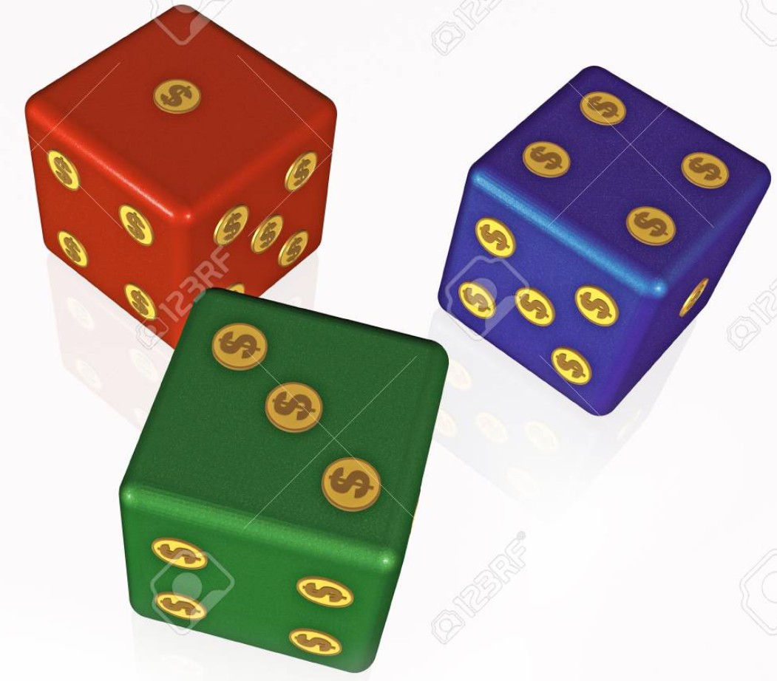
Practice: You have a blue, red, and green dice. How many ways are there to roll a sum of 7 with three standard six sided dice?
1
2
3
4
5
6
7
There are 3 dice and none of them can be zero
The sum is 7, but since none of the dice can be zero, give each dice a value of 1
This will reduce your sum from 7 to 4, so there are 4 rocks
3 dice, so 3 variables, 3 -1 = 2, so 2 sticks
Answer:

Slide 11
Here’s another way to tackle questions when none of the variables can be equal to zero
Remember the 3rd scenario of the chairs and plants?
Count the number of spaces between the chairs!
Ie: How many natural numbers (a,b,c) are there such that a + b + c = 9?
1
2
3
4
5
6
7
8
9
REMOVE!
Put the numbers 1 to 9 down, treat them like rocks or chairs
Count the number of spaces between them: 10 spaces
Remove the 1st space b/c the number can not be zero
You have 3 variables (3plants/sticks) but one of them must be at the end
So you have 8 spaces left with 2 sticks

Slide 12
Q: How many ways can you split 10 rocks into 3 groups?
Place the 10 rocks down and count the number of spaces that you can split them
To split into 3 groups, we need TWO “sticks/plants”
So 9 spaces, choose two to place our sticks
There are 36 ways to split 10 rocks into 3 groups

Slide 13
Ex: Suppose “a”,“b” , and “c” are whole numbers, how many different combinations of (a,b,c) are there if a+b+c=10
“a” “b” and “c” are whole numbers→ means they can be zero
We have 3 terms, so we have 3 dividers
One of the dividers needs to be at the right, so we have only 2 dividers to place
The sum is 10, so we have 10 rocks
The number of spaces is 10+2=12
There are 2 dividers left, so 12C2
1
2
3
4
5
6
7
8
9
10

Slide 14
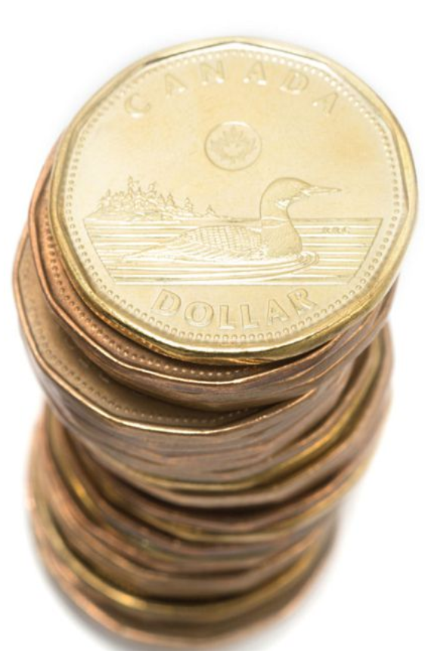
Ex: Suppose David has 12 loonies and he wants to give it to his 4 students. How many ways can he distribute his money?
Treat this question like: a+b+c+d=12, where a,b,c,&d can be equal to zero
Sum is 12, so 12 rocks
There are 4 terms so 4 -1 = 3, we have 3 sticks
Number of spaces will be 12 + 3 = 15
Use these 15 spaces to choose 3 for the sticks
David will have 455 ways to give his 12 loonies to his 4 students
1
2
3
4
5
6
7
8
9
10
11
12

Slide 15
You want to buy a dozen donuts from Tim Horton’s and they only have 5 flavors left. How many ways can you purchase your donuts?
This question is like the previous one , where a+b+c+d+e=12, where a,b,c,d&e can be equal to zero
Since we want to get 12 donuts, sum is 12, the number of rocks is 12
You have 5 flavours to choose from, so we have 5 variables: “a”, “b”, “c”, “d”, and “e”
The number of sticks will be 5 – 1 = 4 sticks
Total spaces needed: 12 + 4 = 16
You have 16 spaces, choose 4 spaces for the sticks
You have 1820 different ways to buy your 12 donuts from Tim Hortons
1
2
3
4
5
6
7
8
9
10
11
12

Slide 16
Suppose you must order one of each flavor, how many ways can you purchase your dozen donuts?
This question is like the previous one , where a+b+c+d+e=12, but a,b,c,d&e can not be equal to zero
Your sum is 12, but since each variable can not be equal to 0, give each variable a value of 1
Your sum will now be reduced, 12 – 5 = 7, so we have 7 rocks
We have 5 variables, so 5 – 1 = 4, so 4 sticks
You have 330 different ways to buy your 12 donuts from Tim Hortons if you must buy atleast one of each flavour
1
2
3
4
5
6
7
8
9
10
11
12

Slide 17
Summary:
In this equation, the sum isn’t fixed at 20. It could be equal or less than 20.
You remember that last stick we also placed at the end? It doesn’t have to be at the end anymore if the sum can be less.
Sum is 20, so 20 rocks. 4 variables, so 4 sticks

Slide 18
There are 4 girls and 10 guys standing in a line. In how many ways can they be arranged if none of the girls are standing next to each other? Note: Suppose all the boys are the same and all the girls are the same
1. Treat the boys as rocks, place the 10 boys down and count the spaces between them
2. There are 11 spaces to place the 4 girls
4. The number of ways to arrange them is 11c4

Slide 19
Given that:
How many different triples of
are possible?
1. What this question is really asking is: you have 3 terms, each ranging from 0 to 5. The 3rd must be equal or greater than the 2nd term. The 2nd term must be greater or equal to the 3rd term
2. Use the sticks and stones method for this. Numbers range from 0 to 5, so 5 rocks
3. You have 3 values, so 3 sticks
3. Suppose this is where you place your sticks
Your 3 numbers will be 0, 2 , 2
The number of ways to choose your 3 values will be:
Your 3 numbers will be 3, 4 , 5
Your 3 numbers will be 1, 1 , 2
1
2
3
4
5

Slide 20
There are 10 parking spaces in a row. 6 cars come in and park. A truck comes in afterwards and requires 2 adjacent spaces to park. What is the probability that the truck can park?
1. First count the number of ways the 6 cars can part in the 10 spots
2. Next count the number of ways that the free spots can not be adjacent to each other
Place the 6 cars down and count the number of spaces between them
There are 7 spaces and you need to choose 4 free spots
In general, you have 210 ways to park all 6 cars. 35 of them are bad, meaning you won’t be able to park the truck. 210 – 35 = 175
That leaves you with 175 good ways. Prob = 175/210 = 5 / 6

Slide 21
1. First, since any two chosen numbers must differ by atleast 2, it means that they can NOT be consecutive
2. So imagine you have 18 spots and you need to pick 5 spots for your number
So, each spot you chose represent the number you picked. Treat these numbers as a ROCK (5 rocks)
The empty spaces will be the sticks (13 sticks)
Since the rocks can NOT be next to each other (not consecutive), give away 4 sticks to be placed in between
So now you have 9 sticks left and 5 rocks. 14 spaces

Slide 22
The following slides are just extras. They cover examples that are more challenging relating to the sticks and stones method.
Ie: The variables can not be the same or maybe the variables must arranged from highest to lowest.
Feel free to browse through these examples

Slide 23
If you have 3 black socks and 6 gold socks, how many ways can you place them so that there will always be 2 gold socks between any two black
4 socks are placed, 2 are left
If you have 5 black socks and 10 gold socks, how many ways can you place them so that there will always be 2 gold socks between any two black
8 socks are placed, 2 are left
With “n” black socks →

Slide 24
Piano method with inequalities
Sample question: a + b + c < 10
The sum is less than 10, can be 9, 8, 7, 6…
With the black keys, instead of choose 2, we choose 3 because the third key on the right determines the sum of the three numbers
Sum =6
Sum =9
Sum =10
1
2
3
4
5
6
7
8
9
10
The hardest part would be finding all the doubles and triples

Slide 25
Suppose “a, “b” and “c” are positive integers, where 0 < a < b < c, how many different combinations of (a,b,c) are there such that: a + b + c < 10
1. Count the total number of combinations where order doesn’t matter and repeats are included
2. Count the triples and doubles and then subtract them
Triples:
3. After we subtract all the triples and doubles, divide by 6 because every 6 is a repeat
Doubles:
There are 7 combinations

Slide 26
Suppose “a, “b” and “c” are positive integers, where 0 < a < b < c, how many different combinations of (a,b,c) are there such that: a + b + c < 100
1. Count the total number of combinations where order doesn’t matter and repeats are included
2. Count the triples and doubles and then subtract them
Triples:
3. Subtract all the triples & doubles, divide by 6 because every 6 is a repeat
There are 24952 combinations
Doubles:

Slide 27
Piano Method:
What would you do if none of the terms can be equal?
Ex: Suppose a + b + c = 10 0<a<b<c
1
2
3
4
5
6
7
8
9
10
With the 9 black keys, we need to select two of them to split the width of 10 into 3 separate parts
Since numbers are different, subtract all the triples & dbles
Permutation of every 6 are the same, divide by 6
Triples:
(none)
We now have 24 combos left, but every 6 is a repeat
Doubles:

Slide 28
Reminders for Piano Method/Sticks and Stones
If the question allows any values to be zero, then use the SS method
If zeroes are not allowed, then use the Piano method
Suppose “a, “b” and “c” are positive integers, where 0 < a < b < c, how many different combinations of (a,b,c) are there such that:
i) a + b + c =10
Note: “a”, “b”, or “c” are not the same
“c” is the biggest, “a’ is the smallest
ii) a + b + c =20
The values a”, “b”, and “c” are not equal to zero
iii) a + b + c < 10
The last two are inequalities, so the sum can be less than or equal to 10
iv) a + b + c <100

